Slide 1
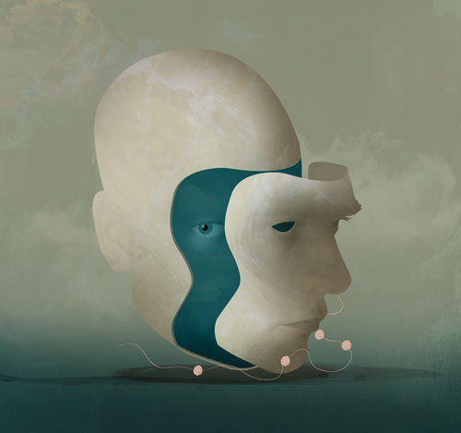
The Self
PH1102E Week 10

Slide 2
Today’s Plan
The importance of the self
A surgical paradox
Solving the paradox
A. Memory-based solution
B. Buddhist solution
C. Schizophrenic solution
IV. Concluding remarks

Slide 3
I. The importancE of the self

Slide 4


Slide 5
Each of us has a special concern for his or her own future.
You care about what is going to happen to you in a way that you do not care about what is going to happen to other people.
That doesn’t mean that you care more about the fate of other people than about your own fate.
But it does mean that you assign a unique kind of importance to your own future as opposed the futures of other individuals.

Slide 6
Each of us has a special concern for his or her own future.
You care about what is going to happen to you in a way that you do not care about what is going to happen to other people.
That doesn’t mean that you care more about the fate of other people than about your own fate.
But it does mean that you assign a unique kind of importance to your own future as opposed the futures of other individuals.

Slide 7
ii. A surgical paradox

Slide 8
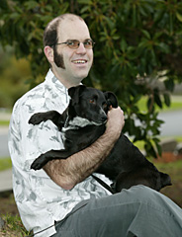
Aaron Purnell, hemispherectomy patient

Slide 9
In a hemispherectomy, surgeons remove half of the patient’s brain, leaving the other half intact.
The operation is performed on people who suffer from constant epileptic seizures, and whose condition resists other forms of treatment.
Aaron Purnell, hemispherectomy patient

Slide 11
A C B
↓ ↓ ↓

Slide 12
A C B
↓ ↓ ↓

Slide 13
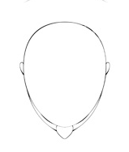
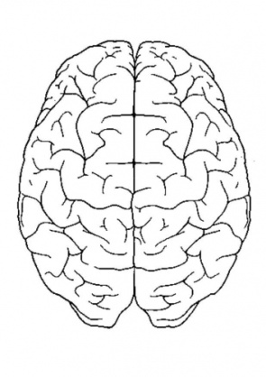
You

Slide 14
You
A-body
B-body

Slide 15
A-body
B-body

Slide 16
A-body
B-body

Slide 17
A-body
B-body

Slide 18
Where are you?
A-body
B-body

Slide 19
A-body
B-body

Slide 20
“I’m not in the A-body or the B-body. I do not survive the operation.”
But you would have survived if the surgeons had transplanted just half your brain and discarded the other half. So how can saving both halves jeopardize your survival?
A-body
B-body

Slide 21
“I’m not in the A-body or the B-body. I do not survive the operation.”
But you would have survived if the surgeons had transplanted just half of your brain and discarded the other half. So how can saving both halves threaten your survival?
A-body
B-body

Slide 22
A-body
B-body

Slide 23
“I’m in the A-body, but not the B-body.”
But any reason you can give for saying you’re in the A-body is also a reason for saying that you are in the B-body!
A-body
B-body

Slide 24
“I’m in the A-body, but not the B-body.”
But any reason you can give for saying you’re in the A-body is also a reason for saying that you are in the B-body!
A-body
B-body

Slide 25
“I’m in the B-body, but not the A-body.”
But any reason you can give for saying you’re in the B-body is also a reason for saying that you are in the A-body!
A-body
B-body

Slide 26
A-body
B-body

Slide 27
“I’m in both bodies!”
But the A-body person is different from the B-body person. How can one person (i.e., you) be two people?
A-body
B-body

Slide 28
“I’m in both bodies!”
But the A-body person is different from the B-body person. How can one person (i.e., you) be two people?
A-body
B-body

Slide 29
The Paradox

Slide 30
The Paradox
We seem to have 4 options:
Say that you don’t survive the procedure.
Say that you survive as the A-body person, but not as the B-body person.
Say that you survive as the B-body person, but not as the A-body person.
Say that you survive as both the A-body person and as the B-body person.
But each of these options appears to face insurmountable objections!

Slide 31
iii. Solving the paradox

Slide 32
Now let’s consider three attempts to solve this paradox, starting with a solution based on the idea that memory is the essence of personal identity.

Slide 33
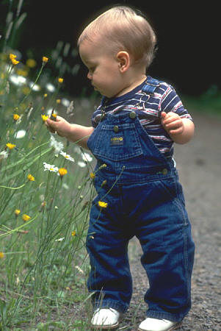

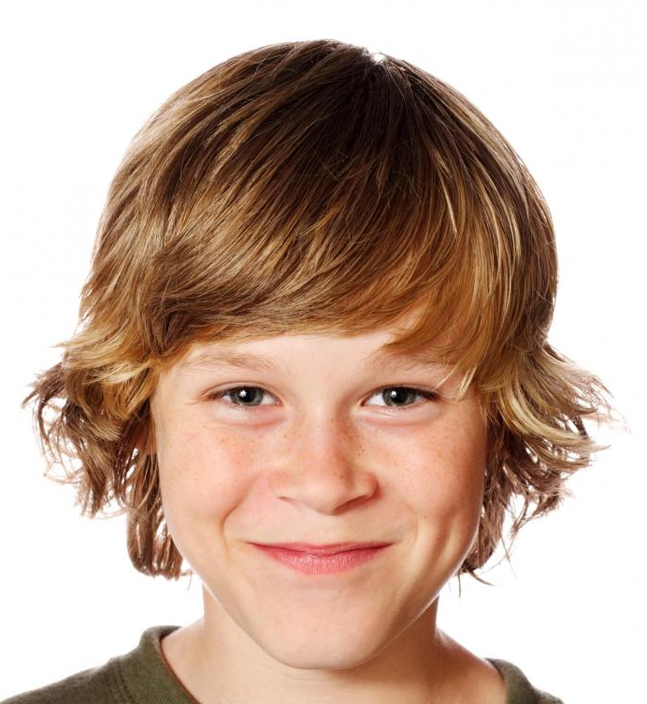
Richie Dick Richard
2004 2014 2024

Slide 34
Memory Theory

Slide 35
Memory Theory
According to the memory theory of the self, you are essentially a thinking thing. Your future = the future of whatever will have first-person memories of your present experiences.
Problem: brain death

Slide 36
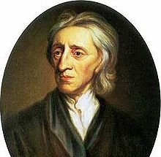
Memory Theory
Richard is the same self as Dick if and only if Richard has first-person memories of Dick.
John Locke (1632-1704)

Slide 37
Richie Dick Richard
2004 2014 2024

Slide 38
Richie Dick Richard
2004 2014 2024
Notes:
Locke’s theory.

Slide 39
Richie Dick Richard
2004 2014 2024
forgetfulness
Notes:
What if Richard can’t remember anything from 2004?

Slide 40
Richie Dick Richard
2004 2014 2024
Notes:
That’s OK, as long as Richard can remember Dick and Dick can remember Richie.

Slide 41
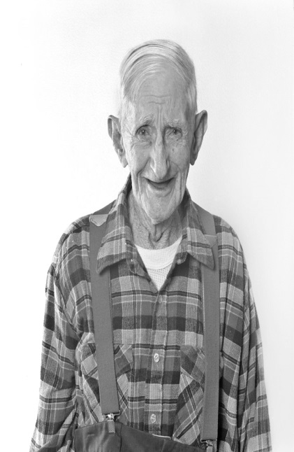
Richie Dick Richard
2004 2014 2084
…
senile dementia
Notes:
What if Old Richard goes senile and can remember only things from his early youth, forgetting everything in between (including Dick’s adventures)?

Slide 42
Richie Dick Richard
2004 2014 2084
…
senile dementia
Notes:
That’s OK, as long as there’s someone (like Richie) whose experiences both Dick and Old Richard can remember.

Slide 43
Richie Dick Richard
2004 2014 2024
amnesia
Notes:
What if Richard suffers from amnesia and can’t remember anything that happened to him before this morning?

Slide 44
Richie Dick Richard
2004 2014 2024
amnesia
Notes:
Then the memory theorist has to say that Richard is not the same person as Dick, Richie, or anyone else who existed before this morning. As a self or person, Richard is less than a day old (although his body is much older).

Slide 45
Memory Theory

Slide 46
Memory Theory
Assuming that the memory theory can overcome all these problems, how does it handle the Surgical Paradox?

Slide 47
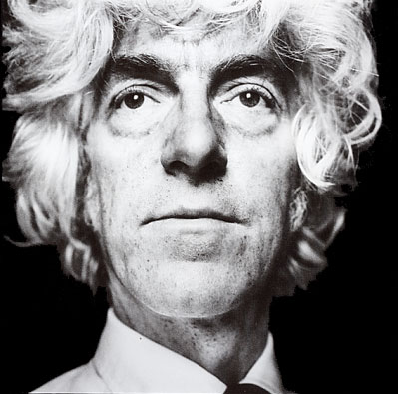
Memory Theory
Assuming that the memory theory can overcome all these problems, how does it handle the Surgical Paradox?
Derek Parfit, Memory Theorist

Slide 48
Memory Theory
Derek Parfit, Memory Theorist

Slide 49
Memory Theory
Survival can be a matter of degree.
You survive to some degree as the A-body person, and to some degree as the B-body person, but you are not identical with either the A-body person or the B-body person.
(Identity requires 100% survival: survival to the highest degree.)
Derek Parfit, Memory Theorist

Slide 51
A Buddhist Solution

Slide 52
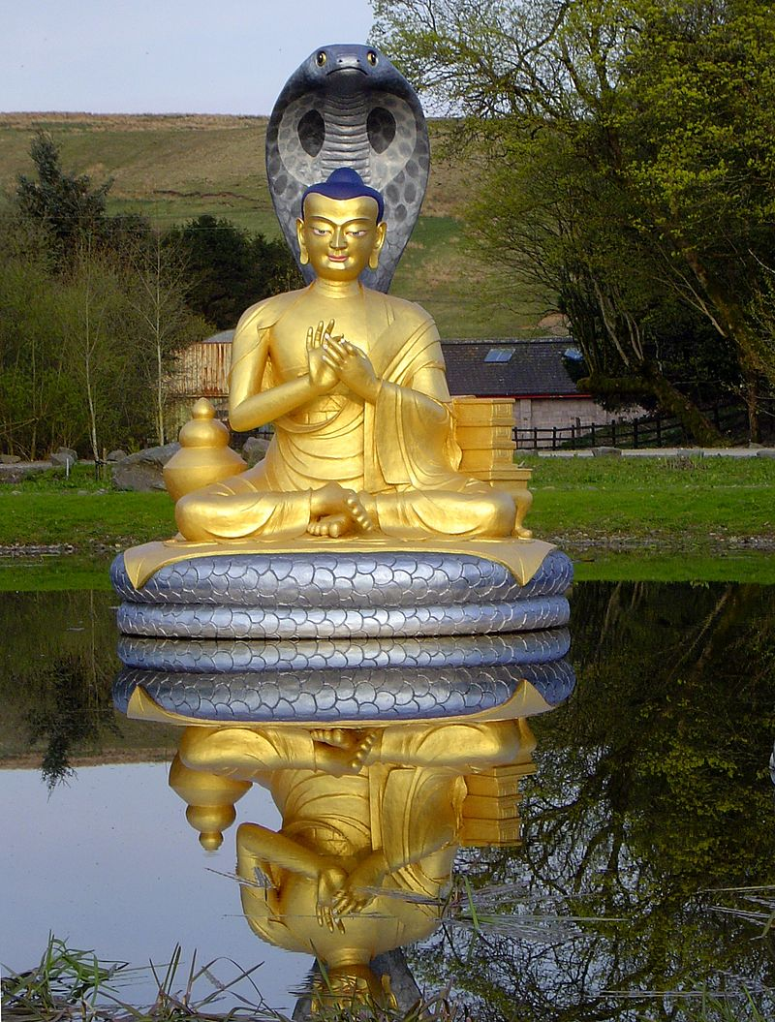
A Buddhist Solution
Nagarjuna, No-Self Theorist

Slide 53
A Buddhist Solution
The key to solving the paradox is to accept that none of the four answers is correct.

Slide 54
A Buddhist Solution
We seem to have 4 options:
Say that you don’t survive the procedure.
Say that you survive as the A-body person, but not as the B-body person.
Say that you survive as the B-body person, but not as the A-body person.
Say that you survive as both the A-body person and as the B-body person.
But each of these options appears to face insurmountable objections!

Slide 55
A Buddhist Solution
The key to solving the paradox is to accept that none of the four answers is correct.
How can this be?
It’s because all the answers make a false assumption: the assumption that you had a self to begin with!
What the paradox teaches us is that the self does not exist.

Slide 56
A Buddhist Solution
The key to solving the paradox is to accept that none of the four answers is correct.
How can this be?
It’s because all the answers make a false assumption: the assumption that you had a self to begin with!
What the paradox teaches us is that the self does not exist.

Slide 57
A Buddhist Solution
The key to solving the paradox is to accept that none of the four answers is correct.
How can this be?
It’s because all the answers make a false assumption: the assumption that you had a self to begin with!
What the paradox teaches us is that the self does not exist.

Slide 59
A Schizophrenic Solution

Slide 60
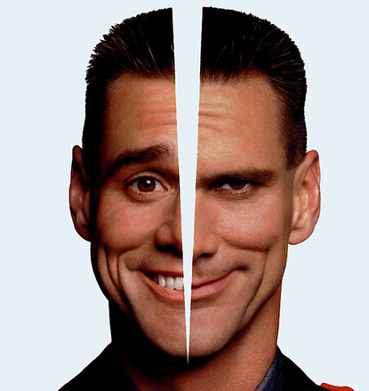
A Schizophrenic Solution

Slide 61
A Schizophrenic Solution
Nagarjuna is correct that the statement of the Paradox contains a false assumption.
But this is not the assumption that you have a self to begin with.
The false assumption is that you started with just one self.

Slide 62
A Schizophrenic Solution
Nagarjuna is correct that the statement of the Paradox contains a false assumption.
But this is not the assumption that you have a self to begin with.
The false assumption is that you started with just one self.

Slide 63
A Schizophrenic Solution
Nagarjuna is correct that the statement of the Paradox contains a false assumption.
But this is not the assumption that you have a self to begin with.
The false assumption is that you started with just one self.

Slide 64
Not “you” singular…
↑

Slide 65
…“you” plural!
↑
↑

Slide 66
To learn more…
PH3242: The Self
PH2204: Introduction to Indian Thought
PH3208: Buddhist Philosophy

Slide 67
End of lecture.

Slide 68
Weekly Assignment #9
Summarize the main argument of Bostrom’s argument in the reading for next week, and raise one objection to the argument that Bostrom does not consider in the reading.
Limit: 200 words.
Submit by 8pm, Thursday 30 October.

